Slide 1
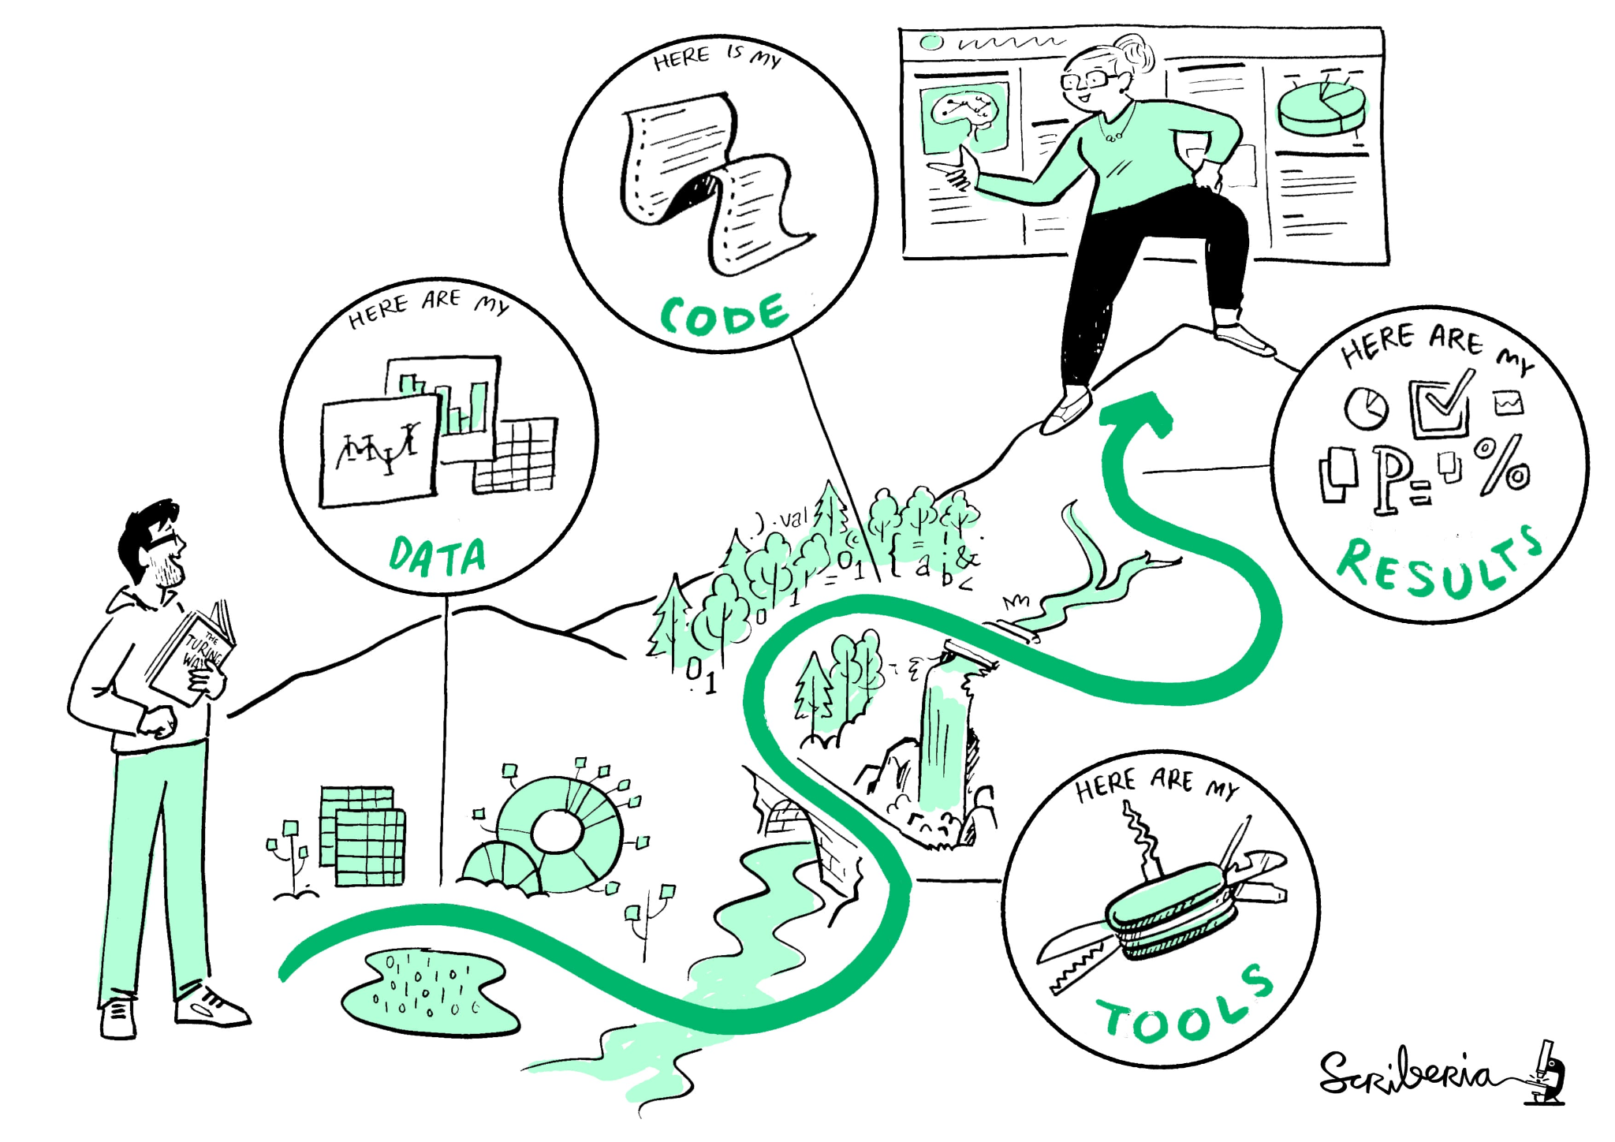
Reproducible Research

Slide 2
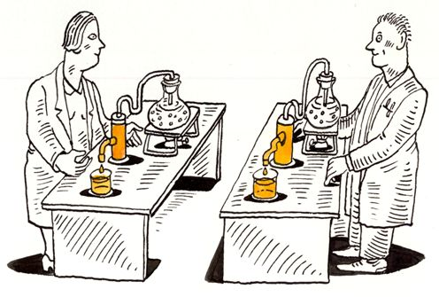
Discussion
What comes to mind when you hear the term “reproducible research”?
Why is it important to make sure your research is “reproducible”?
Does anyone have examples of tools they’ve used to make their work reproducible?

Slide 3
Non-Reproducible Research
What could go wrong if research is not made to be reproducible?
Errors in analysis could be hard or impossible to find
Harder to expand on research for future work
No checks-and-balances for improper science

Slide 4
How can we make research reproducible?

Slide 5
RMarkdown: Why use it?
Allows you to combine code and documentation in one organized document (ex: pdf, html, word doc).
Easily display plots and images along with code and text.
Great for documenting data exploration
Make presentations with code and plots included

Slide 6
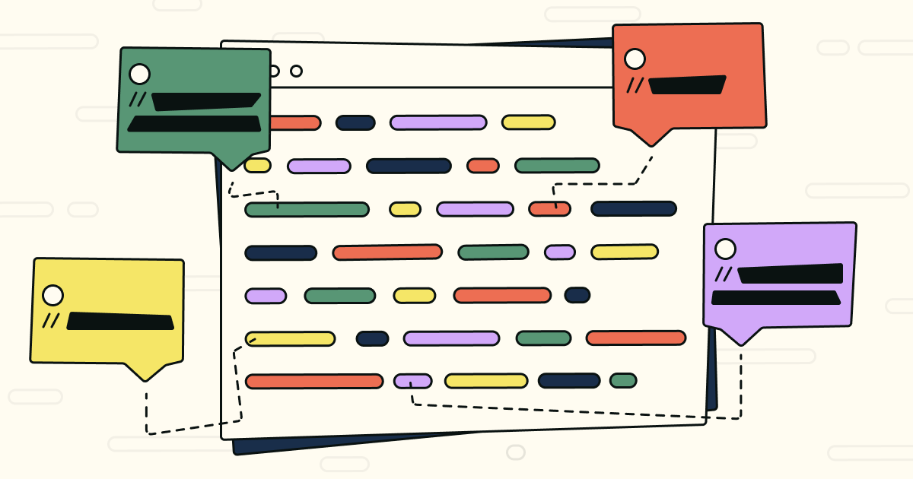
Commenting Code: Why do it?
Allows you and other users to quickly understand the purpose of the code
Speeds up the process of working on and understanding code written by someone else (or you from a long time ago)
Can act as an outline when writing code
Adds context to analysis

Slide 7
Commenting Code: How do I do it?
Comments should be concise
R for Data Science by Hadley Wickham suggests explaining the why rather than the what and how when commenting
Explaining the why helps to add context
A user can look up the what and how, but not the why
Hadley Wickham, M. Ç.-R. (n.d.). R for Data Science (2E). R for Data Science (2e). https://r4ds.hadley.nz/

Slide 8

Version Control
You learned about using Git for version control last week!
Git is a great tool for reproducible research

Slide 9
Document Every Step
Even minor data cleaning steps should be reproducible.
Documenting small edits can seem unimportant at the time, but can save you and others headaches down the line!
Ex: Converting units, dropping NA values

Slide 10
Follow a Project Organization System
Organization systems can vary from project to project
Identify how the people in your project organize their files and follow their lead
When creating an organization system, pick a method and stick to it
Filename conventions
Folder structure
Wilson G, Bryan J, Cranston K, Kitzes J, Nederbragt L, Teal TK (2017) Good enough practices in scientific computing. PLoS Comput Biol 13(6): e1005510. https://doi.org/10.1371/journal.pcbi.1005510

Slide 11
Want to Learn More?
R Markdown Cookbook
R Markdown Cheat Sheet
Good enough practices in scientific computing
Style guide · Advanced R.
R for Data Science (2e)

